Slide 1

Digital Signal Processing: PBL approach
Theme: Music Synthesizer​
Title: Music Genre Classification​
Course: Digital Signal Processing
Course Code: 23EECC303
Semester: V
Faculty /Mentor: Satish S Chikkamath
Team Details
Sl.No. | Roll No. | Div | SRN | Name
1 | 528 | E | 01fe21bec272 | Shivanand Biradar
2 | 529 | E | 01fe21bec273 | Rachanna Ullagaddi
3 | 547 | E | 01fe21bec294 | Madhumati M
4 | 530 | E | 01fe21bec274 | Sonal Sheth

Slide 2
Title: Music Genre Classification
Content
Problem Statement
Introduction
Literature Survey
Functional Block Diagram
Dataset
Methodology
Frequency analysis
Filter design
Results
References

Slide 3
Title: Music Genre Classification
Problem Statement
Classify the Music Genres using Digital Signal Processing​

Slide 4
Title: Music Genre Classification
Introduction
Music Genre: Are the categorical descriptions that are used to describe the music .​
Each category that identifies the music as belonging to a shared tradition or a set of conventions like Hip-Hop, rock, disco.​
Music Genre Classification has its purpose in categorizing the different music, this helps in creating favourite playlist by the users, suggestion of similar music, etc. This process is done using the musical features such as rhythm, melody, harmony, and timbre.​
The classification includes several steps like dataset acquisition, preprocessing of music, analysing by applying Fourier transform, and suitable methods to classify the genre.​

Slide 5
Title: Music Genre Classification
Literature Survey
Sl.No​ | Title​ | Methodology/​ Algorithm​ | Merits ​ | Demerits​ | Gaps ​
1​ | Music Genre Classification Using Transfer Learning.​ | KNN, CNN_MSD,​ CNN_MSD_big.​ | Used CNN like Models, Which give better prediction.​ | Threat of biasing of the model.​ | They used ML instead dsp can be used​
2​ | Modeling Of Audio Effects For Vocal And Music Synthesis In Real Time.​ | Analog modeling.​ | Processing the data in real time​ | Used the analog models​ | No information about chorus etc.​
3​ | Automatic Music Classification and Summarization​ | Support Vector machine learning ,Automatic Summarization Algorithm . | Used for content based music retrieval.​ | It won't work for noisy data​ | Improve the computational efficiency of SVM. ​ ​

Slide 6
Title: Music Genre Classification
Literature Survey
Sl.No​ | Title​ | Methodology/​ Algorithm​ | Merits ​ | Demerits​ | Gaps ​
4​ | A robust music genre classification approach for global and regional music datasets evaluation​ | Robust Selector of Basis Feature Sets​ (RS-BFS)​ ​ | Find a way to get higher accuracy​ (5 fold method)​ | Training is complex.​ ​ | Less diversity in training. So threat of bias.​
5​ | Musical genre classification of audio signals​ | Statistical pattern recognition​ ​ | They created their own dataset​ | Lower accuracy.​ | Sensitivity to the training data.​
6​ | An MATLAB Framework for Music Signal Emotion Analysis and Recognition​ | Bi-LSTM​ | It gives very high accuracy​ | Sensitivity to the training data​ | Expanding the categories.​

Slide 7
Title: Music Genre Classification
Functional Block Diagram
M2
INPUT
FILTER
FFT
OUTPUT
M1
M5
M4
M6
STFT
M3
M1: FFT Freq.
M2: FFT Amplitude.
M3: STFT mean frequencies. M5:Tempo
M4: STFT spectral centroid. M6:ZCR

Slide 8
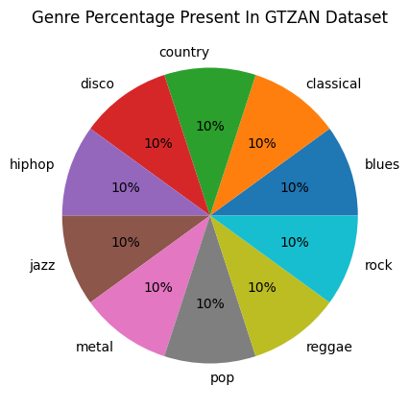
Title : Music Genre Classification
Data Sets/Data Acquisition
GTZAN [7]
It has 1000 audio tracks ,each 30seconds long.
All tracks are 22050Hz Mono 16-bit audio files in .wav format.
Each genre has 100 sample audios.
It has 10 genre of music in it.

Slide 9
Title : Music Genre Classification
Methodology
Take the audio file as input from the user.
Read the file.
Apply the band pass Blackman filter.
Find the model parameters.
Model scoring.
Output.
Reference : [6]

Slide 10
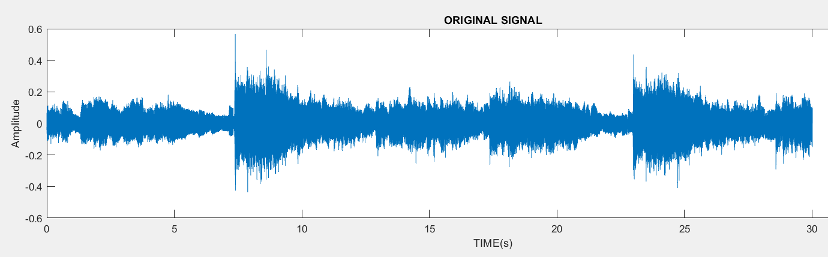
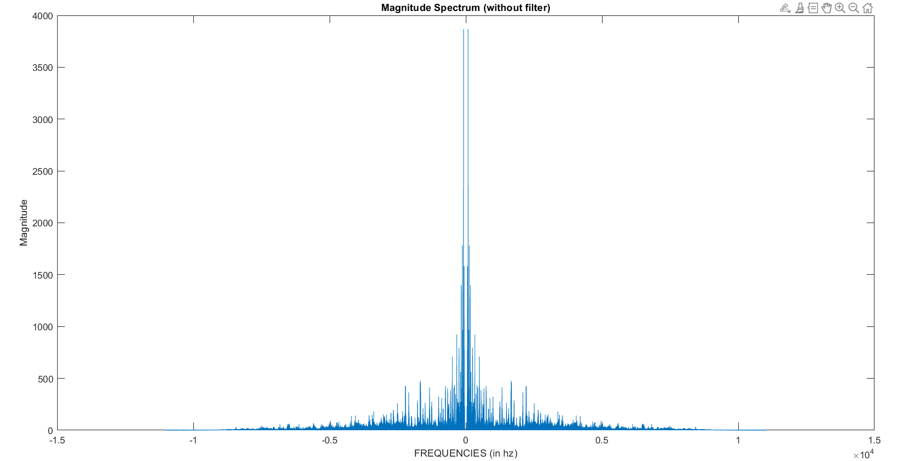
Title: Music Genre Classification
Discrete Fourier Transform
Time domain sequence
Frequency Spectrum

Slide 11
Title: Music Genre Classification
Fast Fourier Transform
Time domain sequence
Frequency Spectrum
DFT vs FFT (661794 Point)
Algorithm | Time Complexity |  | Time | Memory
DFT | O(n^2) |  | 1800s | 83886bytes
FFT | O(n*log2(n)) |  | 0.3585s | 87962bytes

Slide 12
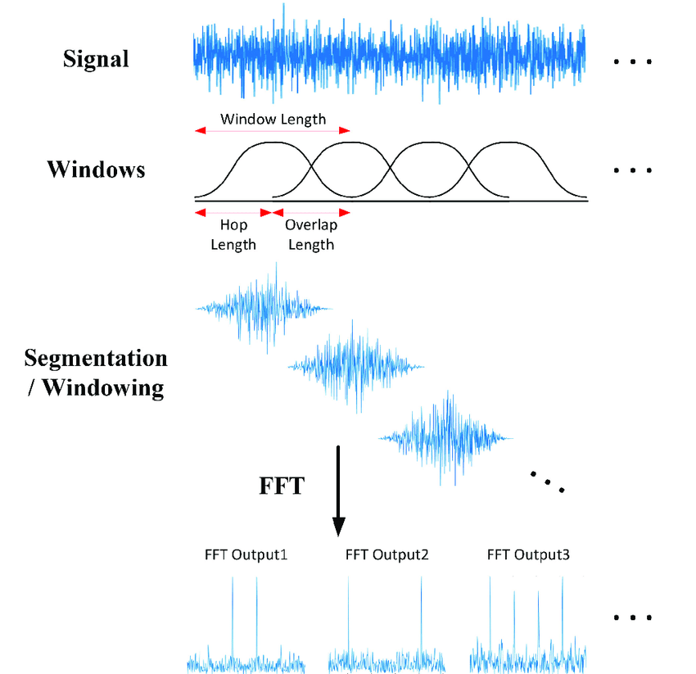
Title : Music Genre Classification
Short Term Fourier Transform
Window length:1024
Overlap Length :512
Reference : https://www.researchgate.net/figure/Short-time-Fourier-transform-STFT-overview_fig1_346243843

Slide 13
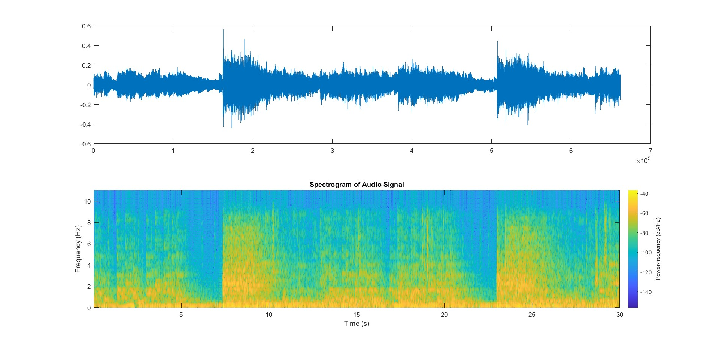
Title : Music Genre Classification
ROCK

Slide 14
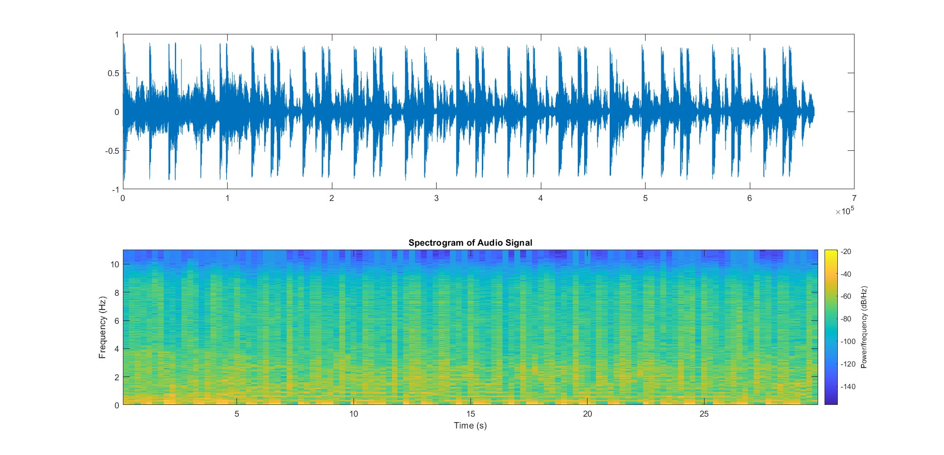
Title : Music Genre Classification
HIPHOP

Slide 15
Title: Music Genre Classification
Digital Filter Design
Justifications for arriving to the below specifications
From the plot of FFT we can conclude the required signal is approximately present in the region between 50Hz-2KHz.
Therefore, we apply a passband filter with the following specifications
Pass band edge frequency1: 50Hz
Pass band edge frequency2: 2KHz
Stop band edge frequency1: 150Hz
Stop band edge frequency2: 2.15KHz
Pass band ripple:10db
Stop band ripple:50db
Order of the filter: (IIR) 54, (FIR) 70
Sampling frequency:22050 hz

Slide 16
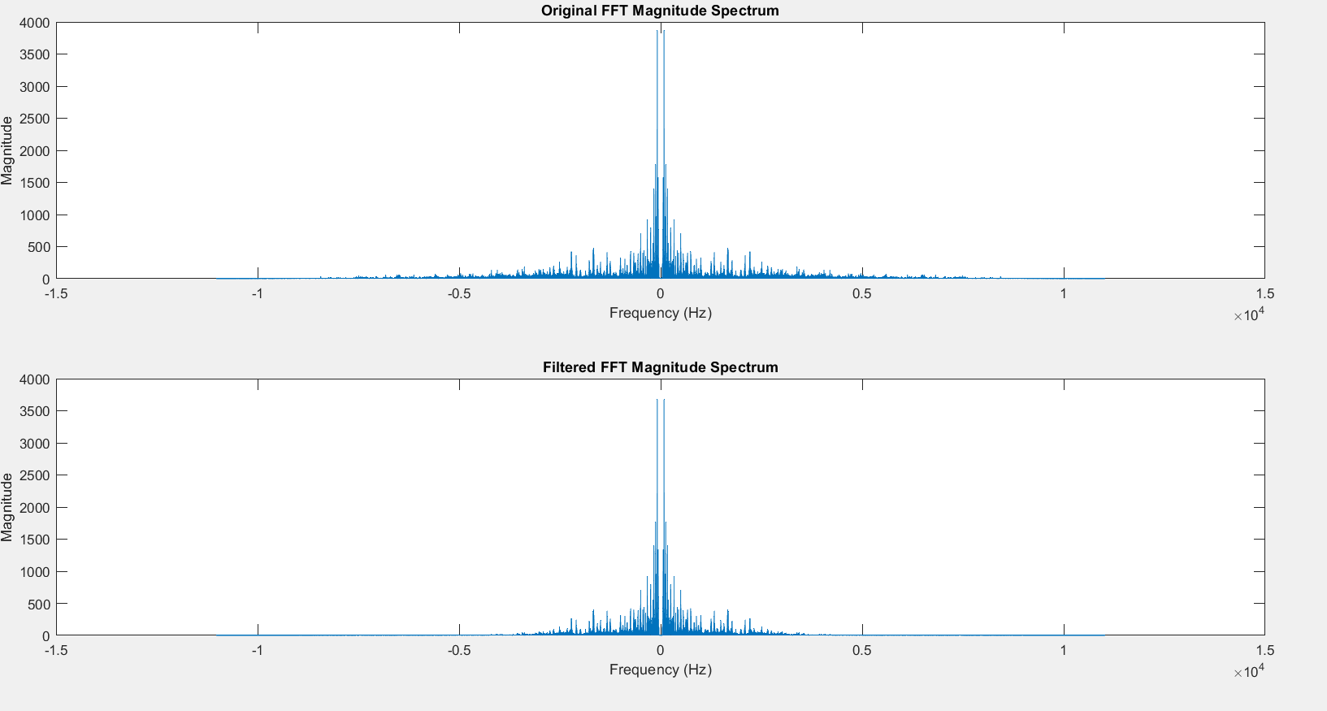
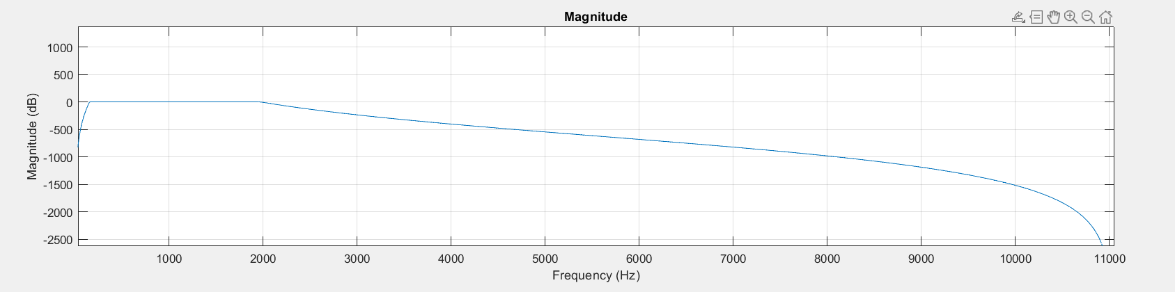
Title: Music Genre Classification
Digital IIR Butterworth Filter Design
Frequency Response of the filter

Slide 17
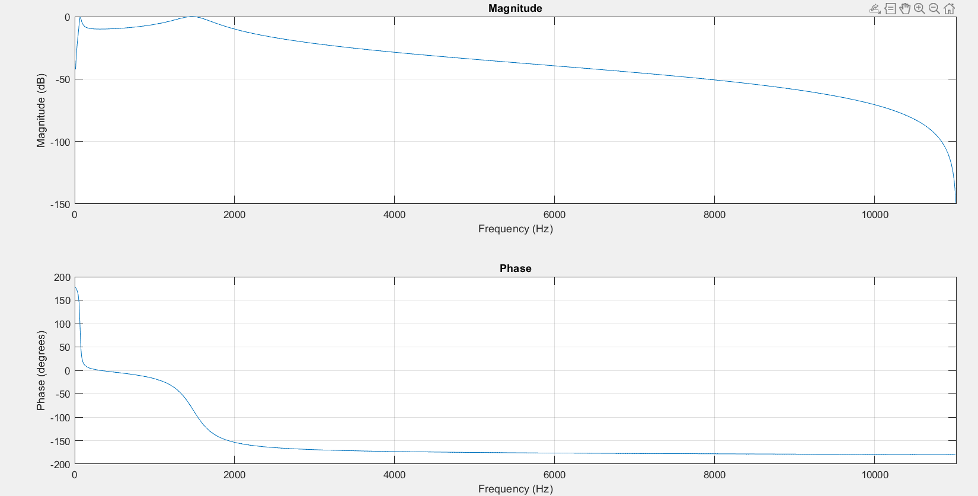
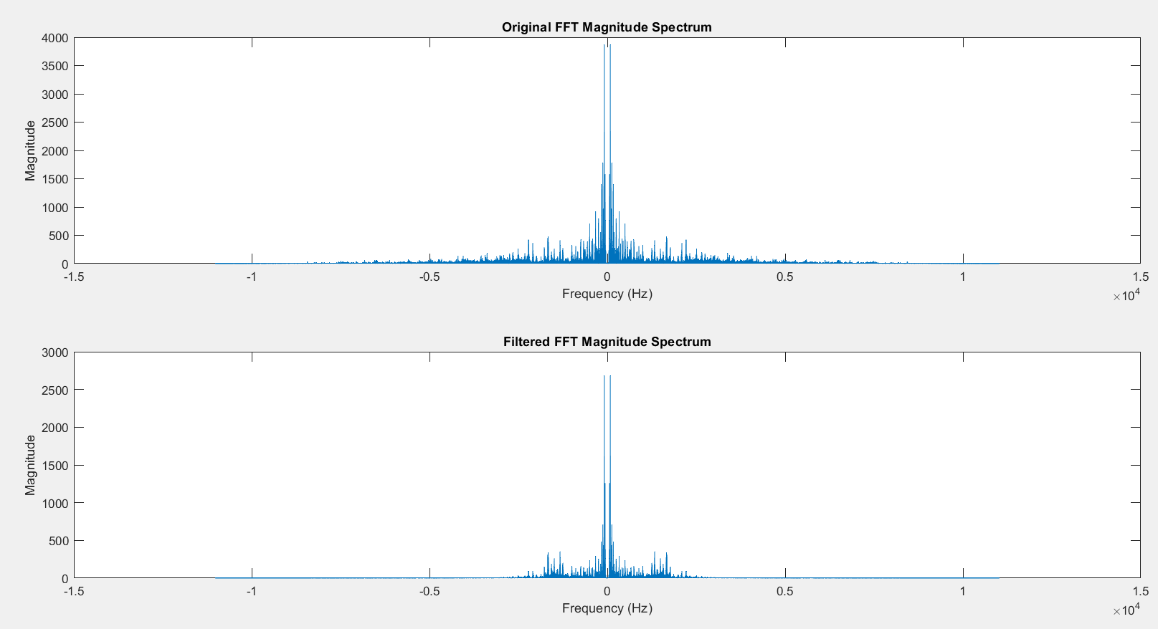
Title: Music Genre Classification
Digital IIR Chebyshev Filter Design
Frequency Response of the filter

Slide 18
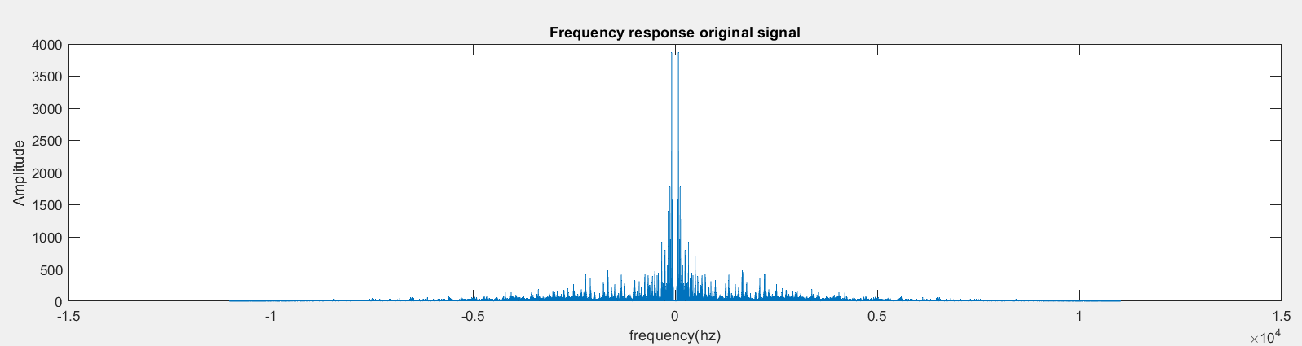
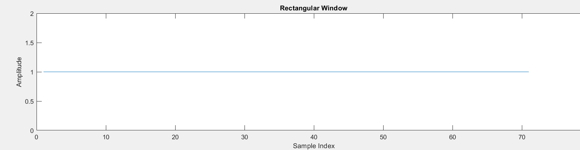
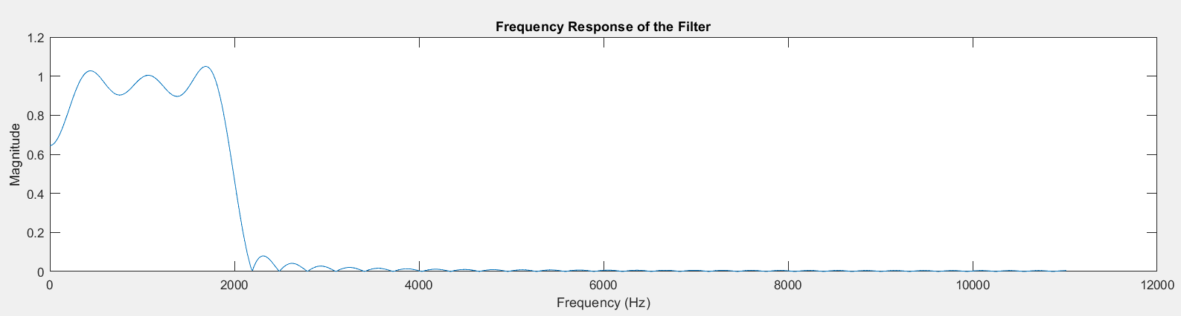
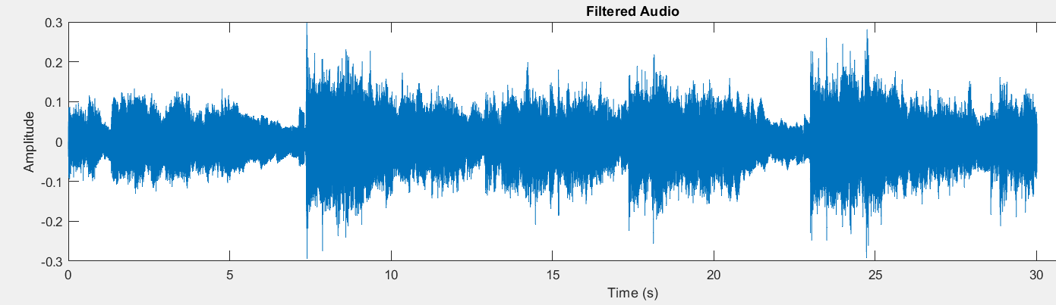
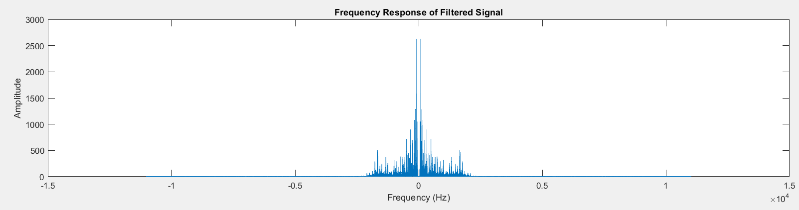
Title: Music Genre Classification
Digital FIR Filter Design
Input Signal
Frequency Spectrum of Input
Rectangular window
Frequency Response of the filter
Output Signal
Frequency Spectrum of Output

Slide 19
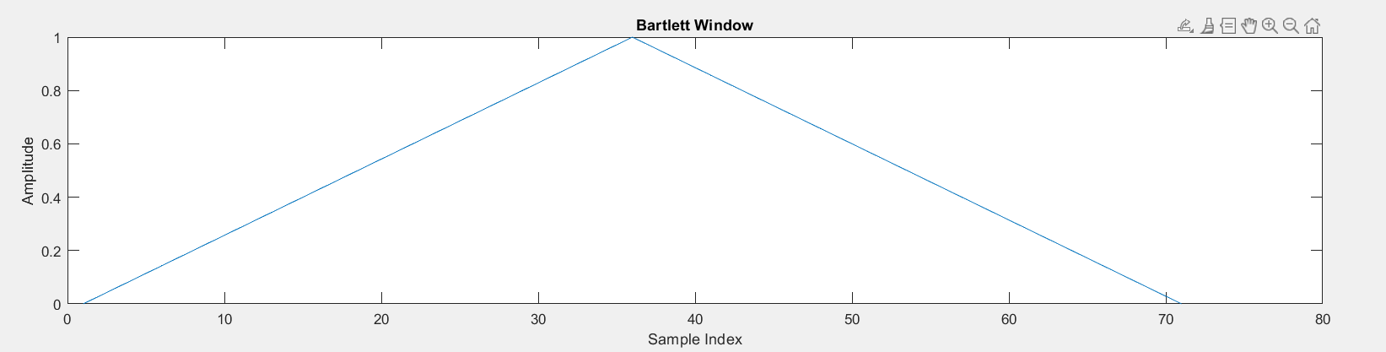
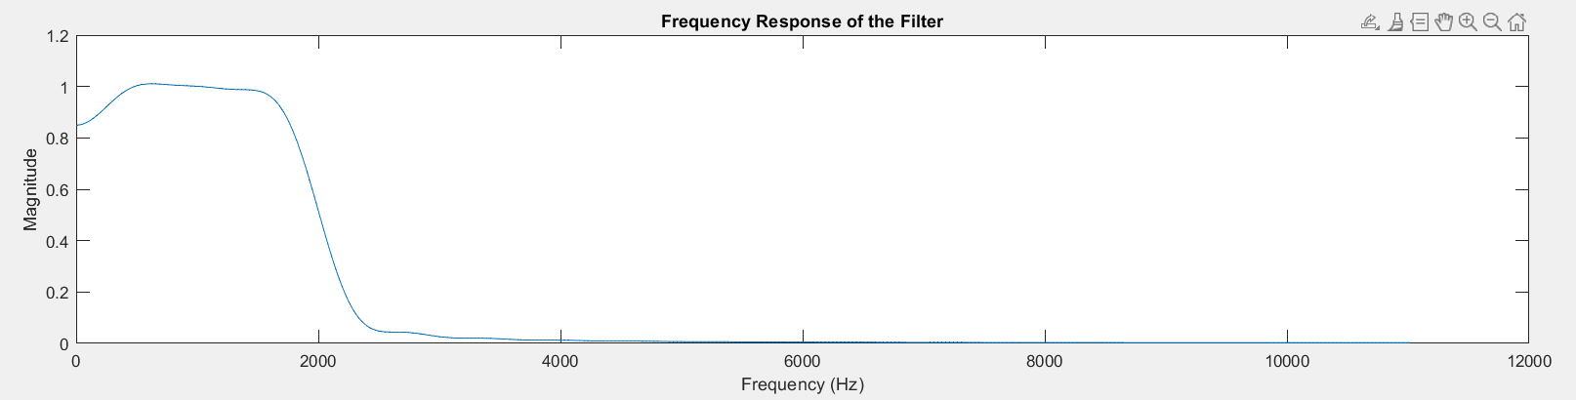
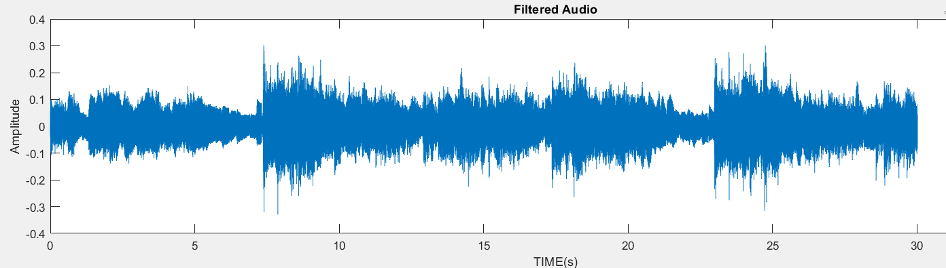
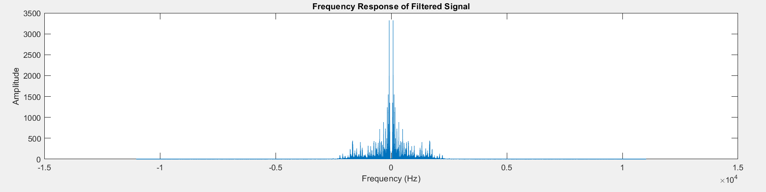
Title: Music Genre Classification
Digital FIR Filter Design
Input Signal
Frequency Spectrum of Input
Bartlett window
Frequency Response of the filter
Output Signal
Frequency Spectrum of Output

Slide 20
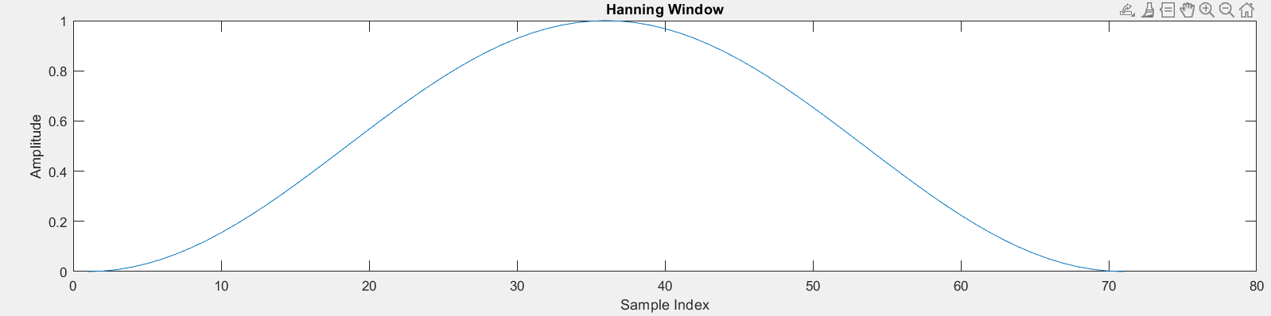
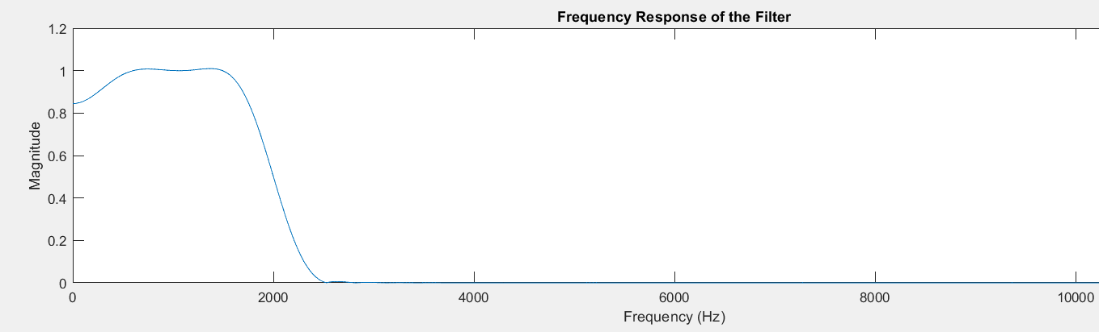
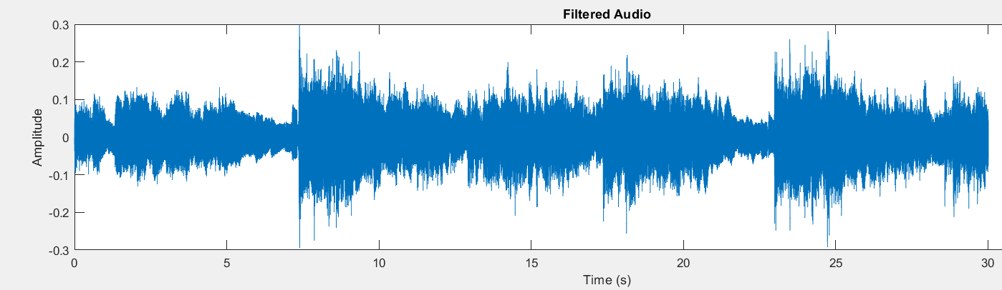
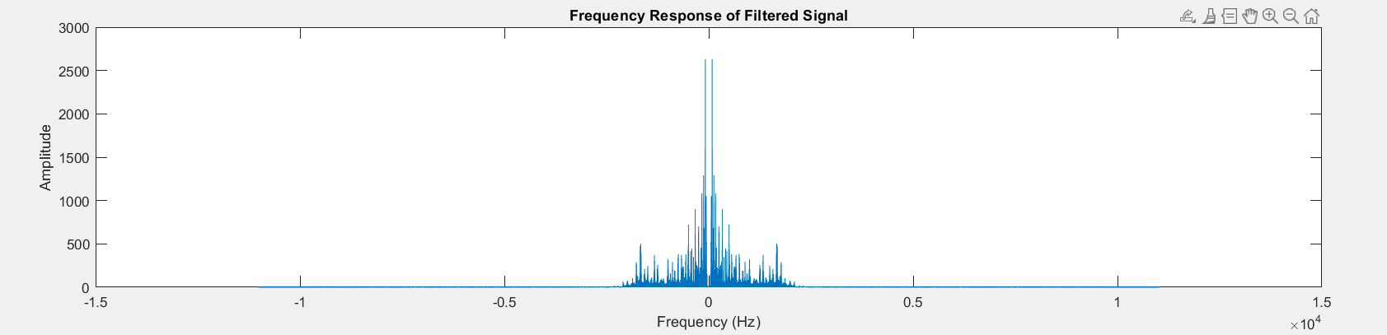
Title: Music Genre Classification
Digital FIR Filter Design
Input Signal
Frequency Spectrum of Input
Hanning window
Frequency Response of the filter
Output Signal
Frequency Spectrum of Output

Slide 21
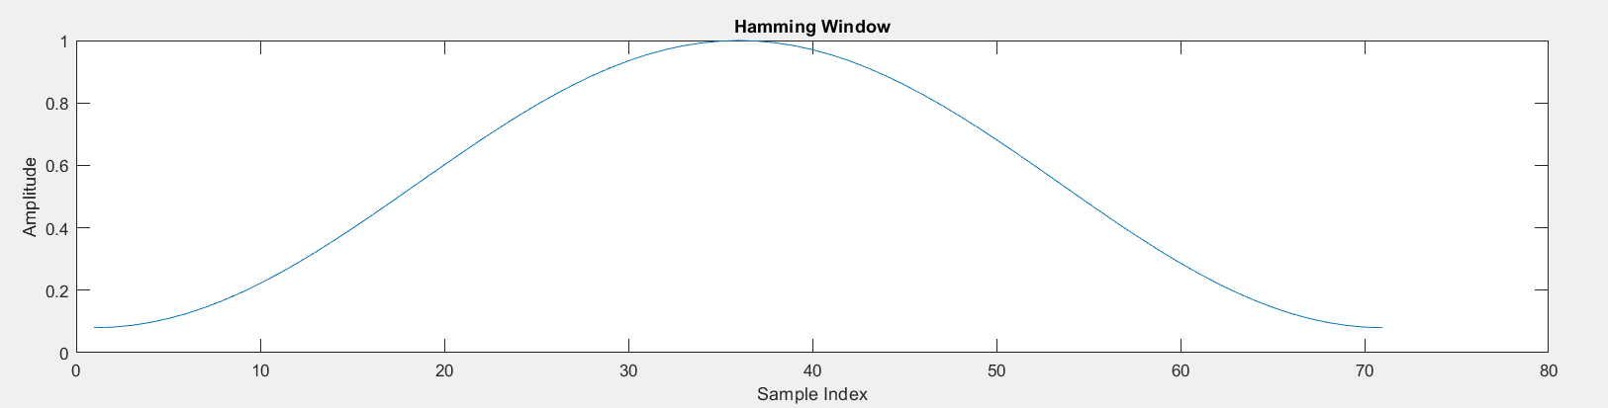
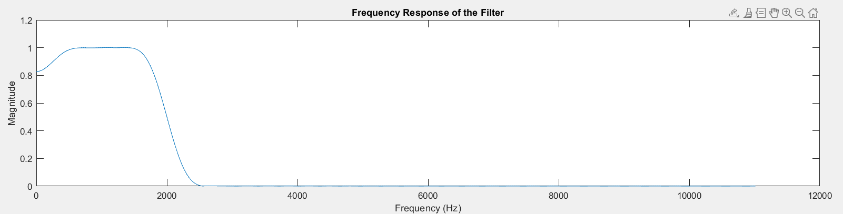
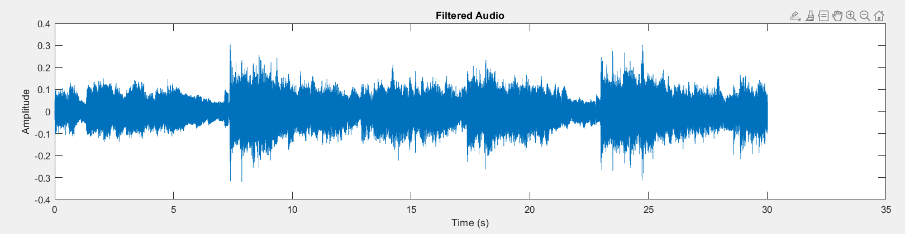
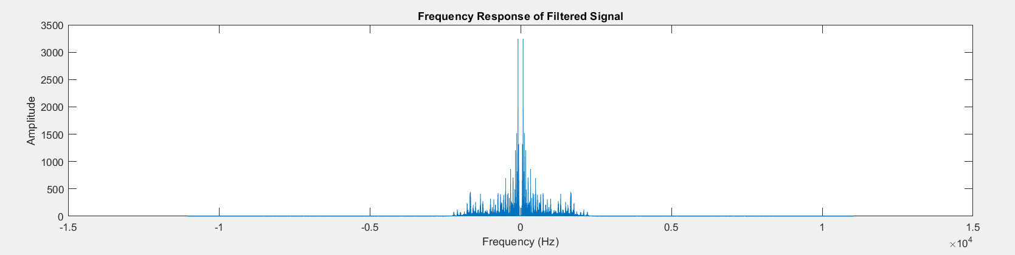
Title: Music Genre Classification
Digital FIR Filter Design
Input Signal
Frequency Spectrum of Input
Hamming window
Frequency Response of the filter
Output Signal
Frequency Spectrum of Output

Slide 22
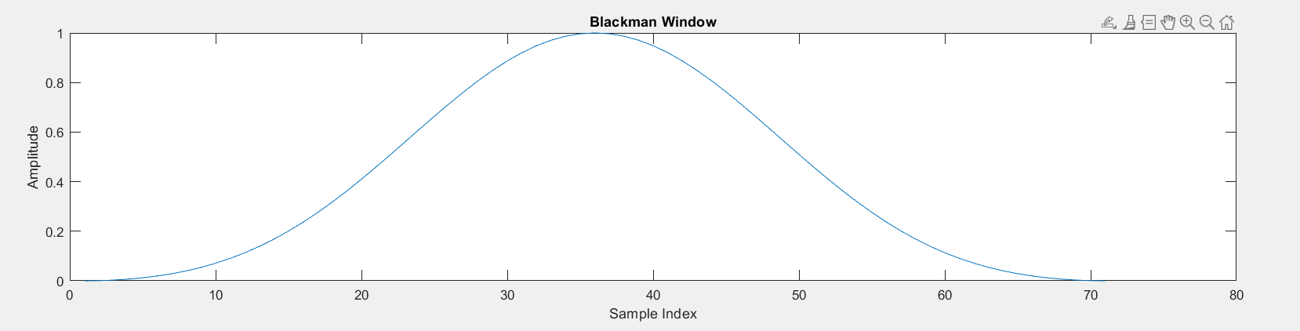
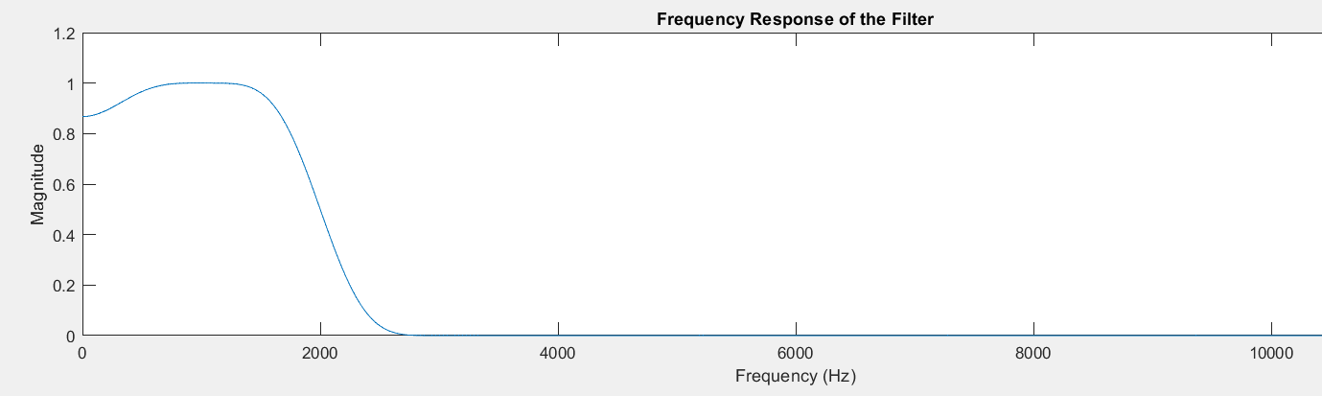
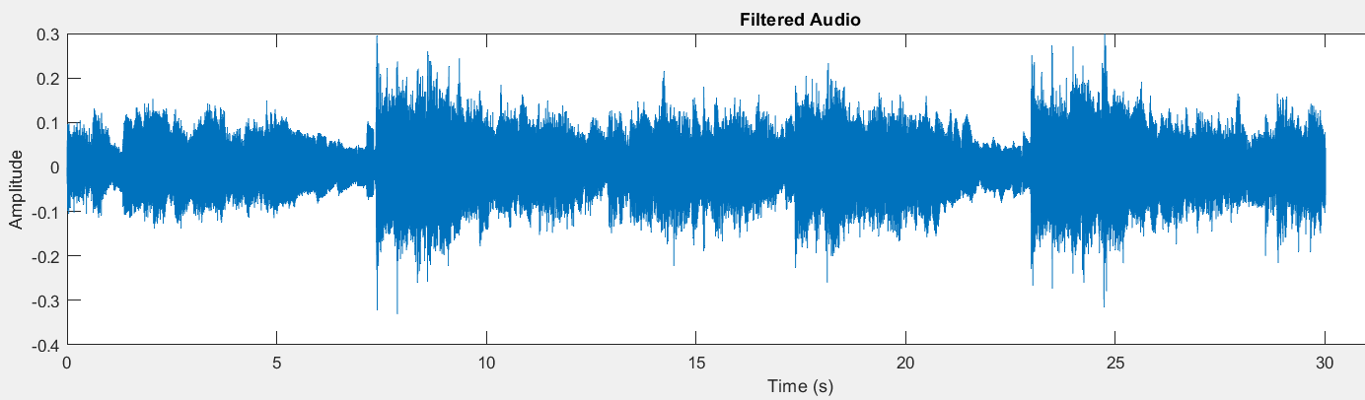
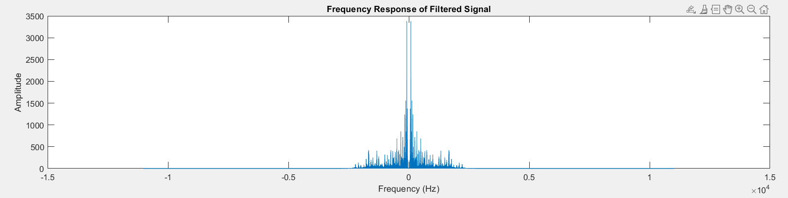
Title: Music Genre Classification
Digital FIR Filter Design
Input Signal
Frequency Spectrum of Input
Blackmann window
Frequency Response of the filter
Output Signal
Frequency Spectrum of Output

Slide 23
Title: Music Genre Classification
The Hanning or the Blackman windows techniques are good for our application
As they are good at mitigating the noise within the order.
As the other techniques have slightly higher passes.

Slide 24
Title: Music Genre Classification
Results

Slide 25
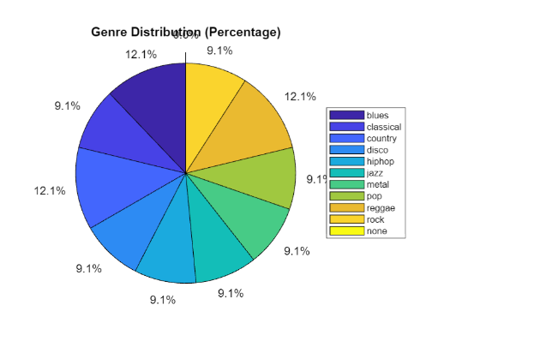
Title: Music Genre Classification
The results for the input audio file that belongs to "blues".
And our model prediction is depicted through the given below pie chart
Input file : Rock (30s, 22050hz (Fs), 16bit mono audio )

Slide 26
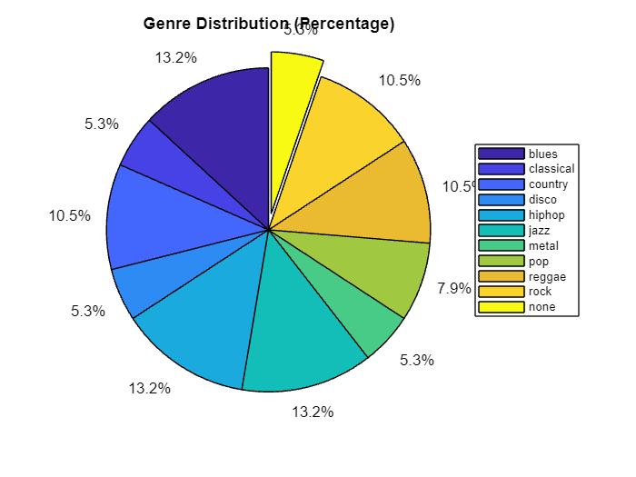
Title: Music Genre Classification
Input file : Metal (30s, 22050hz (Fs), 16bit mono audio )

Slide 27
Title : Music Genre Classification
References
[1] Liang, B., & Gu, M. (2020, August). Music genre classification using transfer learning. In 2020 IEEE conference on multimedia information processing and retrieval (MIPR) (pp. 392-393). IEEE.
[2] D’Souza, D. A., & Shastrimath, V. V. D. (2019, March). Modelling of audio effects for vocal and music synthesis in real time. In 2019 3rd International Conference on Computing Methodologies and Communication (ICCMC) (pp. 1-4). IEEE.
[3] Xu, C., Maddage, N. C., & Shao, X. (2005). Automatic music classification and summarization. IEEE transactions on speech and audio processing, 13(3), 441-450.
[4] De Sousa, J. M., Pereira, E. T., & Veloso, L. R. (2016, October). A robust music genre classification approach for global and regional music datasets evaluation. In 2016 IEEE international conference on digital signal processing (DSP) (pp. 109-113). IEEE.
[5] G. Tzanetakis and P. Cook, "Musical genre classification of audio signals," in IEEE Transactions on Speech and Audio Processing, vol. 10, no. 5, pp. 293-302, July 2002, doi: 10.1109/TSA.2002.800560.
[6] Sumathi, K., Lakshmidevi, P. B., Sindhuja, V., & Nivetha, M. (2023, April). An MATLAB Framework for Music Signal Emotion Analysis and Recognition. In 2023 International Conference on Recent Advances in Electrical, Electronics, Ubiquitous Communication, and Computational Intelligence (RAEEUCCI) (pp. 1-5). IEEE.
[7] time-hp.jp | 522: Connection timed out
[8] GTZAN Dataset - Music Genre Classification (kaggle.com)

Slide 28
Title: Music Genre Classification
Thank You

